Slide 1


- An Automated system for real-time smart street light and efficient maintenance in cities.
INTELLILIGHT
Presented by :
RESHMA A- 210701211
RESHMA S - 210701213
SANDHYA S - 210701226

Slide 2

1 | ABSTRACT
2 | OBJECTIVE
3 | PROBLEM STSTEMENT
Agenda
4 | EXISTING SYSTEM
5 | PROPOSED SYSTEM
6 | SYSTEM ARCHITECTURE
REFERENCE PAPERS
7

Slide 3


Abstract
Exploring IoT for smart streetlights, this project integrates automatic light control based on sunlight intensity ,motion and a fault detection system with alerts.
LDR automates light based on sunlight, infrared adjusts brightness for efficiency and safety.
IR senses for motions and increases the brightness of LED.
Motion-sensing optimizes energy and enhances safety in India's tech-driven smart streetlights.

Slide 4

Traditional lighting systems lack automation and remote control, leading to inefficient energy usage.
Introduction
Manual operation of lights can be inconvenient and does not leverage sensor data for optimal functionality
So to overcome this our project aims to develop a smart lighting system that integrates LDR and IR sensors with Blynk for efficient and automated light control.

Slide 5



Objective
Goals 1
Goals 2
Goals 3
Enhance Energy Efficiency
Remote Monitoring and Control
Increase Security and Convenience
Goals 4
User-Friendly Interface

Slide 6

Existing System
Automated street lighting using PLC offers efficiency, low operating costs, and low maintenance costs.
GSM-based smart street light control system involves timed switching via a client-server setup with a GSM modem and microcontroller.
Automatic Street Light Control System employs a microcontroller (PIC16F877A) with LDR and photoelectric sensors to eliminate manual operation and save energy.

Slide 7

Proposed System
Dual Mode Operation: Provides automatic adjustment based on light and motion sensors, with manual control via the Blynk app.
Remote Control: Utilizes the Blynk IoT platform for remote monitoring and control of the LED system, allowing mode switching and brightness adjustments.
Energy Efficiency: Enhances energy savings and security by adjusting LED brightness according to ambient light and motion detection.

Slide 8
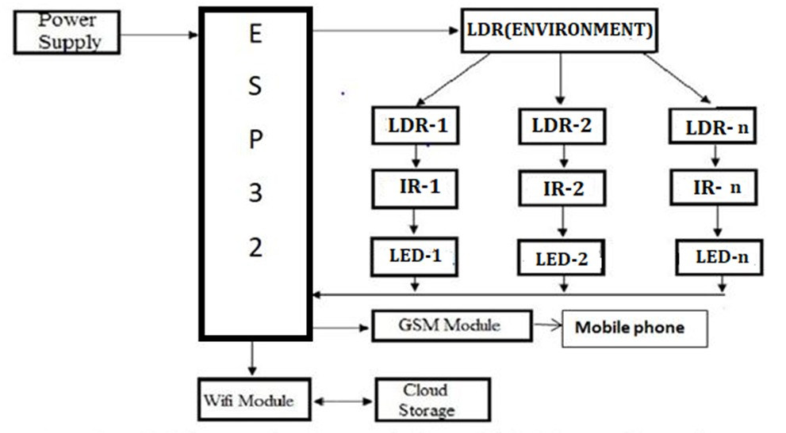
System Architecture

Slide 9
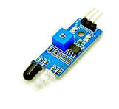
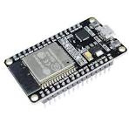
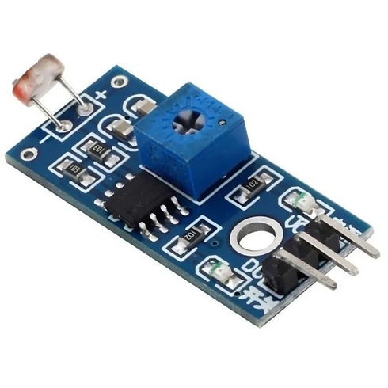

HARDWARES INVOLVED
IR Sensor
ESP32
LDR
LED

Slide 10


SOFTWARE INVOLVED
BLYNK IOT
ARDUINO IDE

Slide 11
MODULE DESCRIPTION
Hardware Integration: Setup and configuration of ESP32, LDR, IR sensors, and LEDs.
Software Development: Programming the ESP32 using Arduino IDE and Blynk library integration.
System Functionality and Testing: Operation in automatic and manual modes with testing results.
Blynk Integration: Remote monitoring and control setup using the Blynk app.

Slide 12
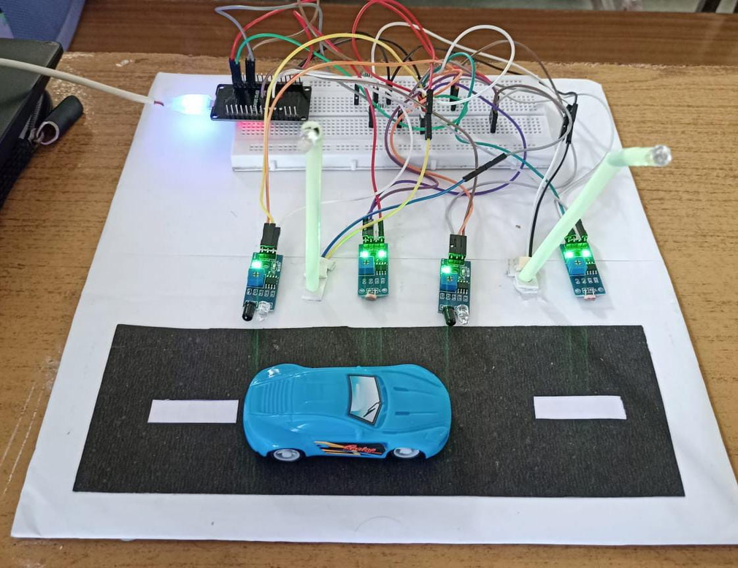
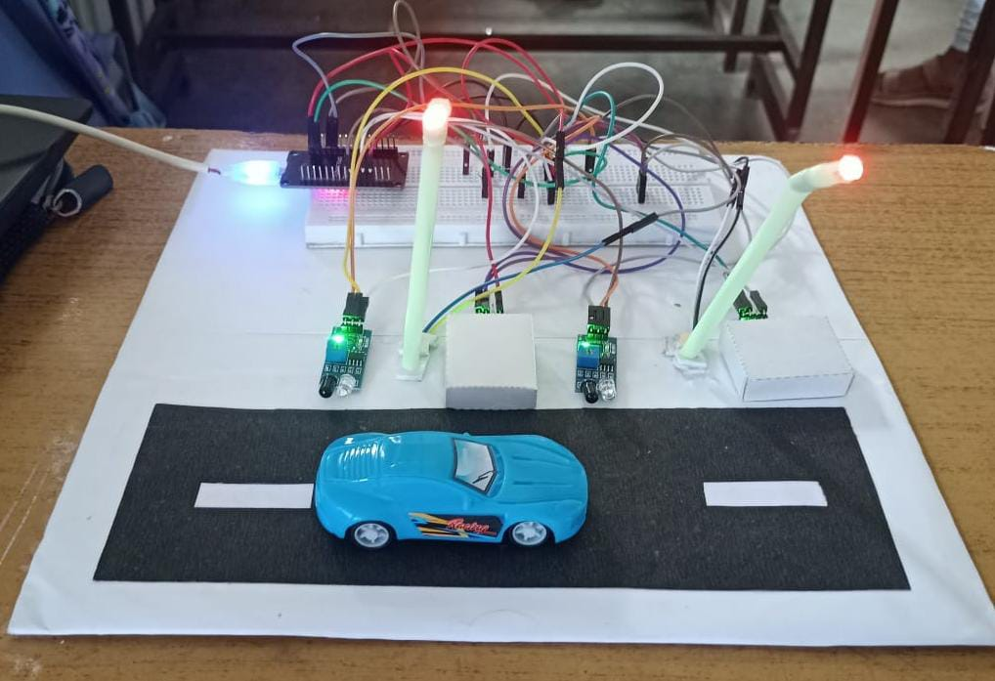
OUTPUT

Slide 13
CONCLUSION
Energy Efficiency: Automated LED control based on light and motion reduces energy use.
Remote Control: Blynk app integration allows easy remote monitoring and control.
Versatility: Supports both automatic and manual modes for user flexibility.
Scalability: Easily expandable for more sensors and lights.

Slide 14
Reference Papers
Agar Deo, Sachin Prakash and Asha Patil, “ZigBee-based Intelligent Street Lighting System”, 2nd International Conference on Devices, Circuits and Systems (ICDCS), 2014.
Amey Manekar, J., Dr. Kshirsagar, Dr. R .V. (2016). ” Design and Implementation of Automatic Street Light Controller for Energy Optimization Using FPGA”, International Journal of Advanced Research in Comp
Vaishali Gupta, Krutika Thakur, Ritesh Thakur, “Based Smart Street Lights” International Journal of Research (IJR), Volume 2, Issue 10, October.

Slide 15
Prashanth. S U et al, “IoT Based Smart Street Lighting System,” International Journal of Engineering Research & Technology (IJERT), Volume 10, No. 08, 2022
D.K. Saini et al, "Auto Streetlight Control with Detecting Vehicle Movement," Advances in Energy Technology, Springer, Singapore, pp. 279-288, 2022
N. Sravani et al., "Street Light Controlling and Monitoring of Fault Detection using LoRa," International Journal for Modern Trends in Science and Technology, vol. 7, no. 12, pp. 242-245, 2021.
Ashok Kumar Nanduri et al, “IoT based Automatic Damaged Street Light Fault Detection Management System,” (IJACSA) International Journal of Advanced Computer Science and Applications, Vol. 11, No. 8, 2020.
C. Subramani et al., "Energy Efficiency and Pay-Back Calculation on Street Lighting Systems," The 11th National Conference on Mathematical Techniques and Applications, AIP Conf. Proc., vol. 2310, no. 1, 2019.
G.PRAVEEN et al , “National Highway Street Light Faulty Detection & Monitoring System,” Journal of Emerging Technologies and Innovative Research (JETIR), Volume 6, No. 4, April 2019.

Slide 16
Intelligentsystem for monitoring andcontrolling of street lightusing the GSMtechnology, International conference on information processing, December 16- 19, 2015, by Swati rajes Parekar, prof ManojM. Dongre.
B. K. Subramanyam, K. Bhaskar Reddy, P. Ajay Kumar Reddy, “Design and Development of Intelligent Wireless Street Light Control and Monitoring System Along With GUI”, International Journal of Engineering Research and Applications (IJERA)Vol. 3, Issue 4, Jul- Aug 2013, pp.2115- 2119.
Anila Devi Y, V. Jaya Prakash, “GSM Based Remote Control System of High Efficiency Intelligent Street Lighting System Using A Zigbee Network of Devices and Sensor” International Journal of Science and Research (IJSR) P.P 2319- 7064.
B.Abinaya, S.Gurupriya, M.Pooja “IOT BASED SMART AND ADAPTIVE LIGHTING IN STREET LIGHTS ”2017 Second International Conference On Computing and Communications Technologies(ICCCT‟17)
Veena P C, Paulsy Tharakan, Hima Haridas, Ramya K, Riya Joju, Ms. Jyothis T S “Smart Street Light System based on Image Processing”2016 International Conference on Circuit, Power and Computing Technologies [ICCPCT]

Slide 17

REshma S & Reshma A , Sandhya S
Thank You

